Slide 1
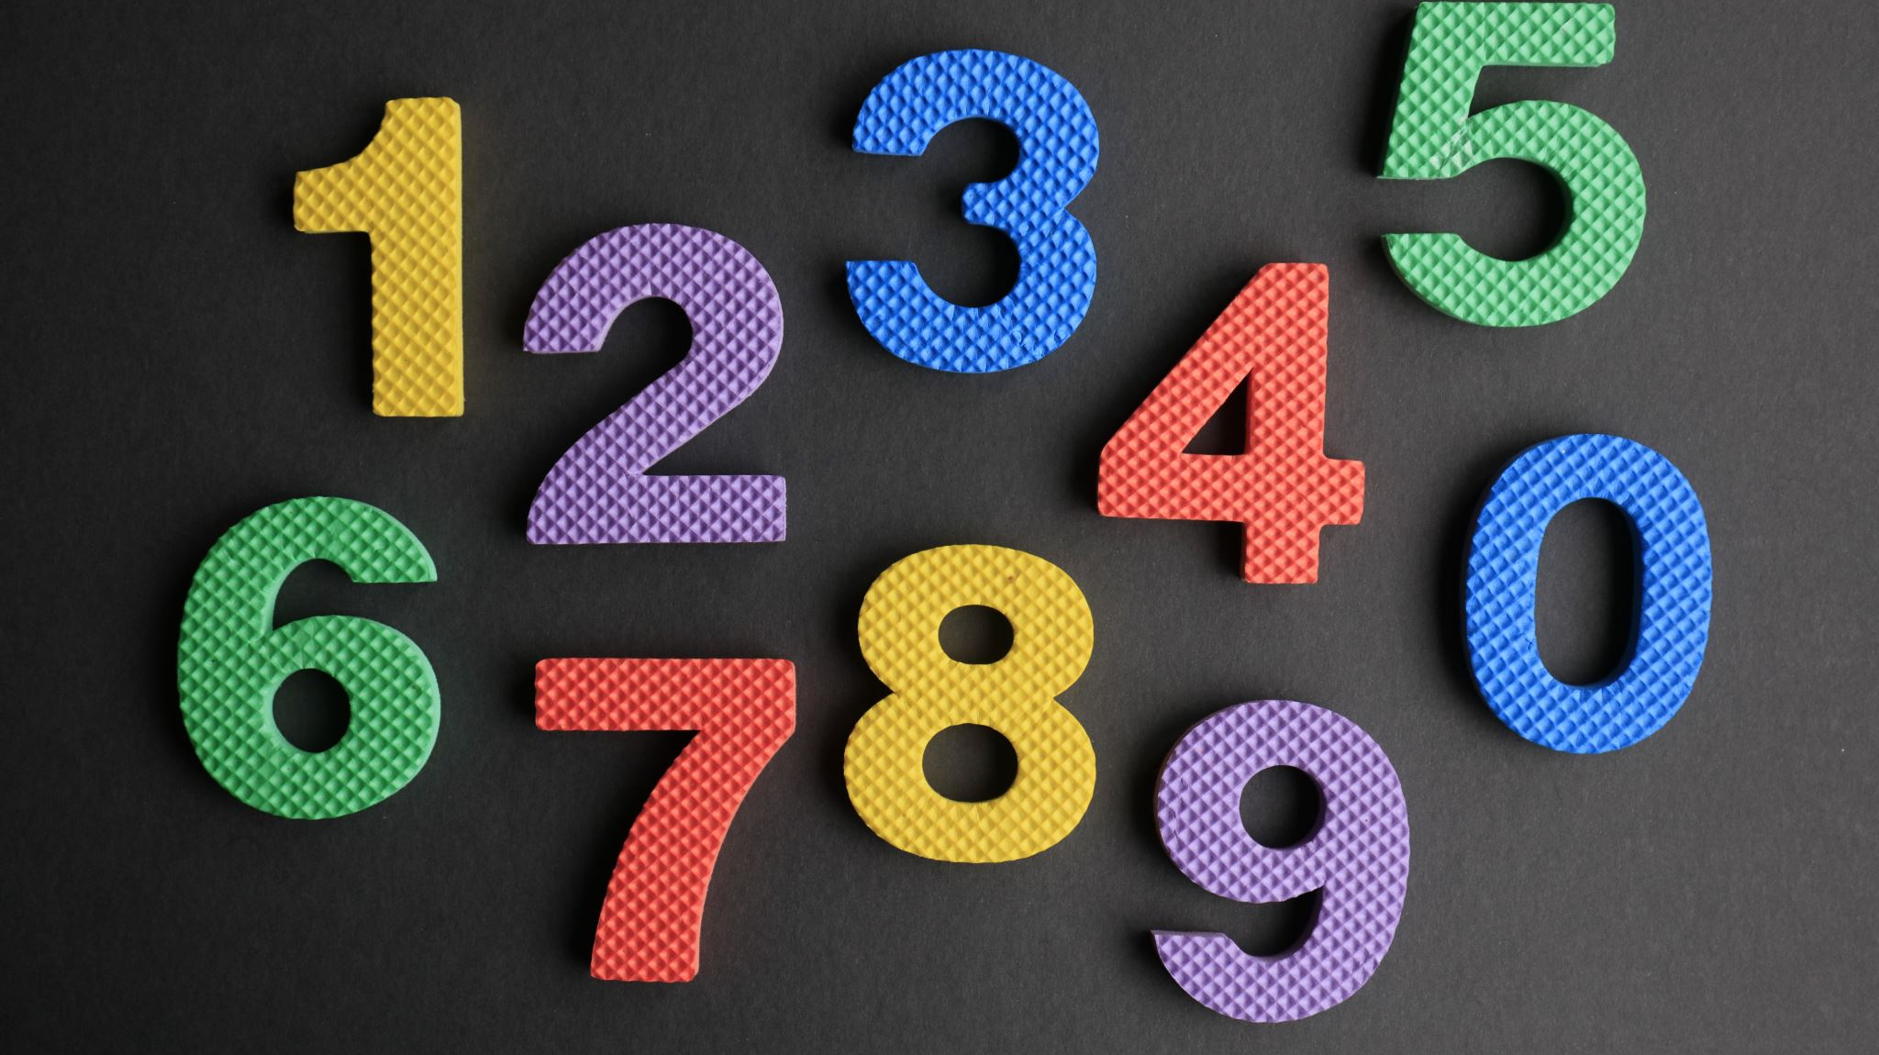
1.NUMBERS
QUANTITATIVE APTITUDE
HARSHA S VIJAYAKUMAR

Slide 2
NUMBER SYSTEMS
Natural numbers: The counting numbers which are used for counting are known as natural numbers, i.e. 1,2,3,4,5…
Whole numbers: On including '0' in the natural numbers we get the whole numbers, i.e. 0,1,2,3,4,5,6,7,8…
Integers: The whole numbers including the negative numbers and excluding fractions are known as integers, e.g. -5,-4,-3,-2,-1,0,1,2,3,4,5. So, integers can be positive(1,2,3,4,5), negative(-5,-4,-3,-2,-1) or zero(0)
Prime numbers: A whole number having exactly 2 factors including 1 & itself . e.g. 2,3,5,7,11.

Slide 3
NUMBER SYSTEMS
Co-prime numbers: Two natural numbers p and q are said to be co-prime if their H.C.F. is 1, e.g. (2, 3) (4, 5) (7, 9) (11, 9)
Composite number: It refers to a whole number which is greater than 1 and is not a prime number. It can be divided by numbers other than 1 and itself e.g. 4,6,8,9,10,12.
Even number: An integer which is divisible by 2 is known as an even number e.g. 2,4,6,8...
Odd number: An integer which is not divisible by 2 is known as an odd number e.g. 1,3,5,7,9...

Slide 4
NUMBER SYSTEMS
Rational number: The numbers in the form of p/q where p and q are integers and q can't be zero are known as rational numbers, e.g., 22/7, 5/3, 0/11, -143/15.
Irrational numbers: The numbers which when written in decimal form do not terminate and repeat are known as irrational numbers. These numbers cannot be expressed as a ratio of integers or as a fraction, e.g.√2,√3,√5, π, etc.

Slide 5


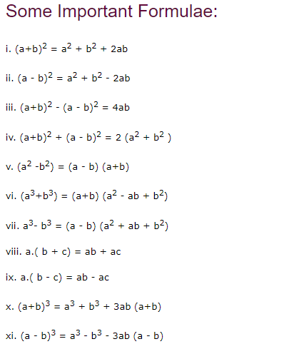




Slide 6
DIVISIBILITY RULES
Divisible by 2 | A number that is even or a number whose last digit is an even number, i.e., 0, 2, 4, 6, and 8.
Divisible by 3 | The sum of all the digits of the number should be divisible by 3.
Divisible by 4 | The number formed by the last two digits of the number should be divisible by 4 or should be 00.
Divisible by 5 | Numbers having 0 or 5 as their one's place digit.
Divisible by 6 | A number that is divisible by both 2 and 3.
Divisible by 7 | Subtracting twice the last digit of the number from the remaining digits gives a multiple of 7.
Divisible by 8 | The number formed by the last three digits of the number should be divisible by 8 or should be 000.
Divisible by 9 | The sum of all the digits of the number should be divisible by 9.
Divisible by 10 | Any number whose ones place digit is 0.
Divisible by 11 | The difference of the sums of the alternative digits of a number is divisible by 11.
Divisible by 12 | A number that is divisible by both 3 and 4.

Slide 7
1) Convert the following decimals to fractions
a)0.777....
b)0.233333....
b)0.23232323.....
c)0.324242424.....

Slide 8
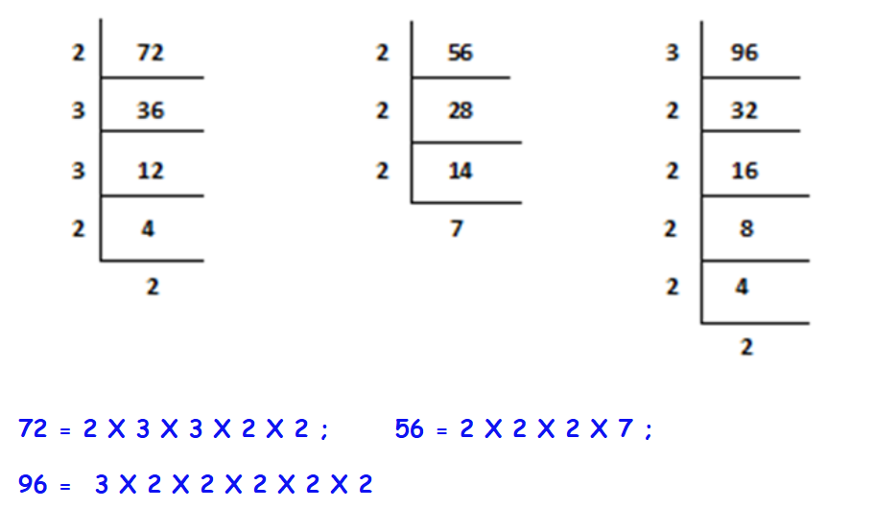
PRIME FACTORIZATION
Factorization using prime numbers
Eg: 2,3,5,7,11,13….

Slide 9
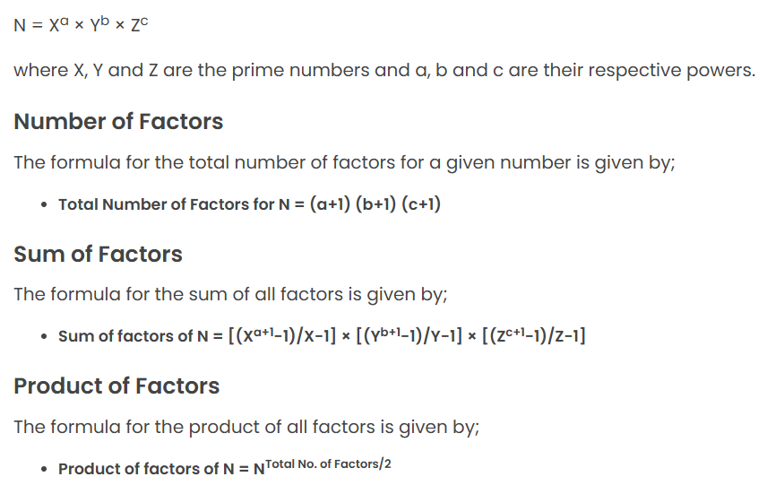
Total Sum & Product of factors of a Number

Slide 10
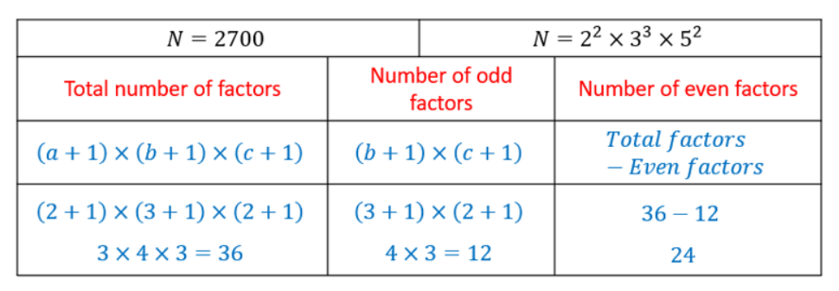
Total no of Factors of a Number

Slide 11
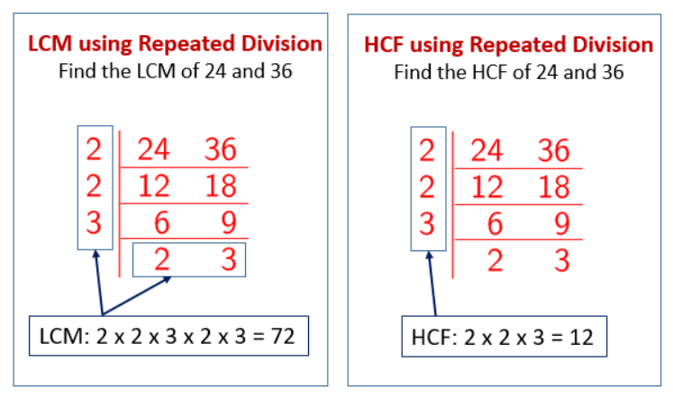
LCM & HCF

Slide 12
1) Find the LCM&HCF of the following
a)36,90,48
b)24,36,144
b)5/7,10/9,15/14
c)2/3,4/9,8/15

Slide 13
2)The product of 2 numbers is 18750 and their LCM is 750 then, find the HCF of the numbers
B)50
D)100
A)25
C)75

Slide 14
3)What is the least number which when divided by 12, 15, and 18 leaves a remainder 7 in each case?
B)207
D)157
A)187
C)197

Slide 15
4)Find the least number which when divided by 8, 12, 20 and 36 leaves remainders 6, 10, 18 and 34 respectively.
B)370
D)378
A)366
C)358

Slide 16
5)The greatest number of four digits which is divisible by 15, 25, 40 and 75 is:
B)9600
D)9800
A)9000
C)9400

Slide 17
6)Find the greatest number which when divides 259 and 465 leaves remainders 4 and 6 respectively.
B)37
D)95
A)51
C)93

Slide 18
7)Let N be the greatest number that will divide 1305, 4665 and 6905, leaving the same remainder in each case. Then sum of the digits in N is:
B)5
D)8
A)4
C)6

Slide 19
REMAINDER THEORAM
Rules pertaining to x^n–y^n
(i)It is always divisible by x –y (i.e., x –y is always a factor of xn–yn).
(ii)It is also divisible by x + y when n is even.
(iii)It is not divisible by x + y when n is odd.
Rules pertaining to x^n+ y^n
(i)It is never divisible by x -y (i.e., x –y is never a factor of x^n+ y^n).
(ii)It is divisible by x + y whenever n is odd.
(iii)It is not divisible by x + y when n is even.

Slide 20
1)Find the remainder when 47 x 52 is divided by 6
B)2
D)4
A)1
C)3

Slide 21
2)Find the remainder when (321) ⁵⁶⁸⁷ is divided by 8
B)5
D)4
A)1
C)3

Slide 22
3)Find the remainder when (146) ⁵⁶ is divided by 7
B)6
D)4
A)1
C)3

Slide 23
4)Find the remainder when (269) ⁵⁶⁵⁸⁷ is divided by 6
B)5
D)4
A)1
C)3

Slide 24
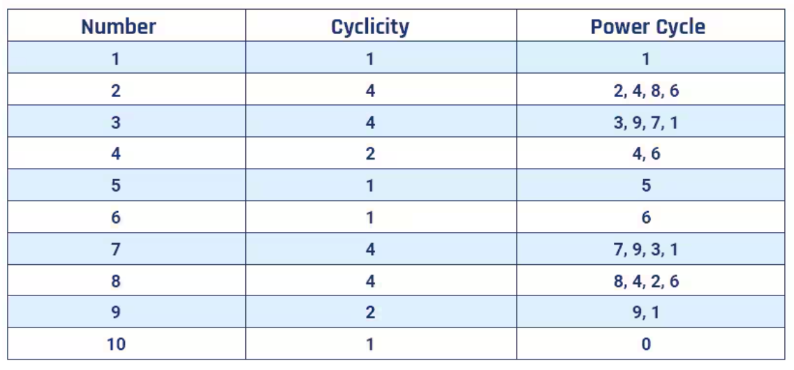
LAST DIGIT

Slide 25
1)What is the last digit of (269) ⁵⁶⁵⁸⁷
B)9
D)4
A)1
C)3

Slide 26
2)What is the last digit of (322) ⁵⁶⁸⁷
B)4
D)8
C)6
A)2

